Slide 1
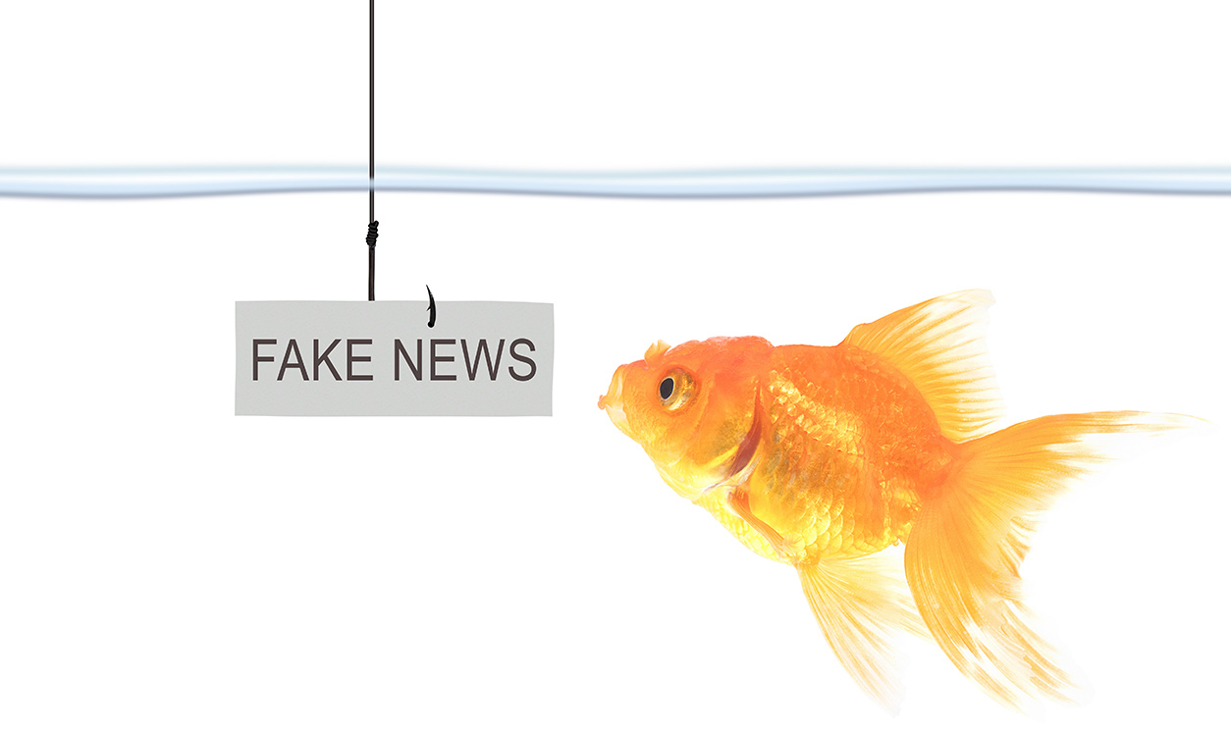

Fighting Fake News: Image Splice Detection
via Learned Self-Consistency
Graziano Specchi, Omar Bayoumi, Cristiano Bellucci

Slide 2
Index
Model
Model architecture and EXIF exploitation.
Training and Testing
Optimizer, loss function, learning rate.
Conclusions
What we learned, what we would like to do as future improvements.
Introduction
Brief problem description.
Preprocessing
Batch and Patch creation.
Test and Results
Paper’s test set and results about our own tests.

Slide 3

Introduction
1

Slide 4
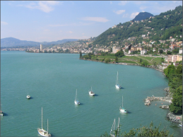
Is this image fake?
2

Slide 5
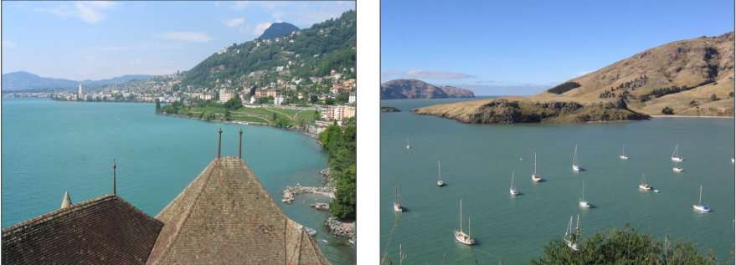
Is this image fake?
3
Yes!

Slide 6
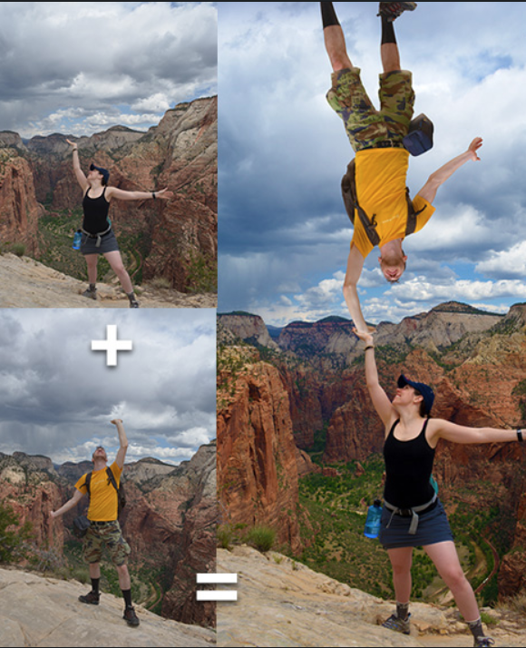
Problems
2
Few technologies to detect fake images
Many technologies to create fake images
Little-size Datasets of fake images

Slide 7
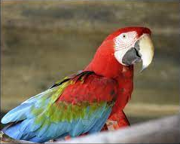
What information does this image give us?
3

Slide 8
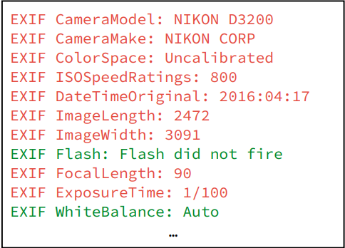
What information does this image give us?
4
EXIF Data

Slide 9
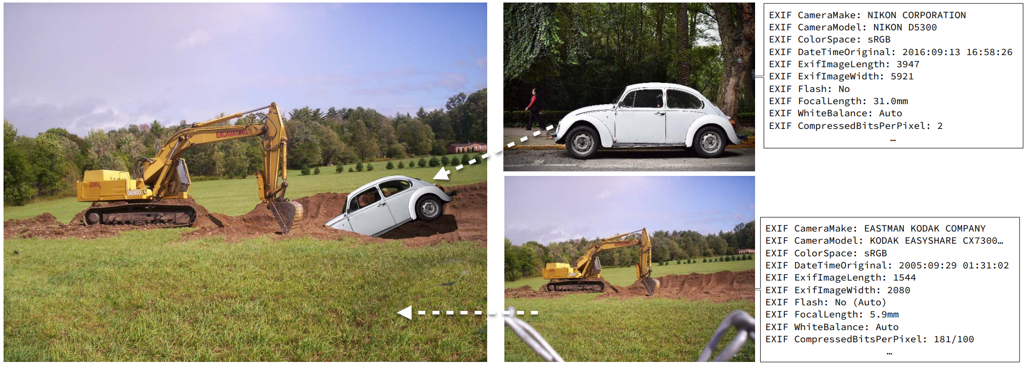
5
Different images have different EXIF Data

Slide 10
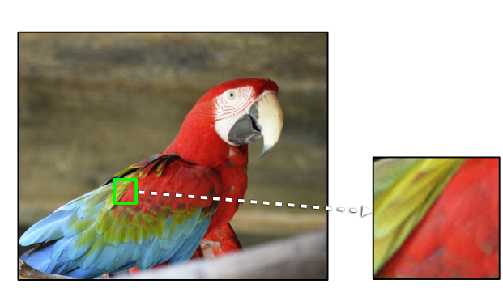
Self Consistency
6
Each patch from the same image should have the same EXIF Data

Slide 11

Model
2

Slide 12
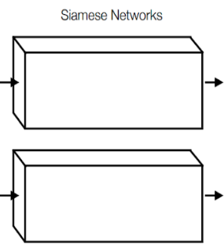
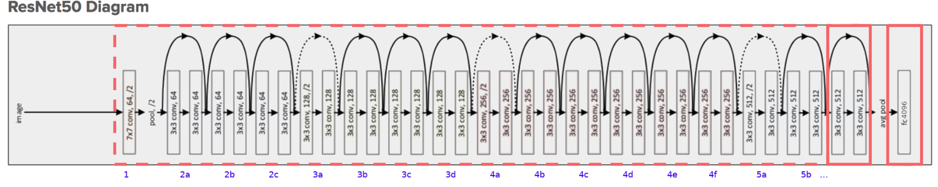
Model: Resnet50
8
Original output features
What we added
55

Slide 13
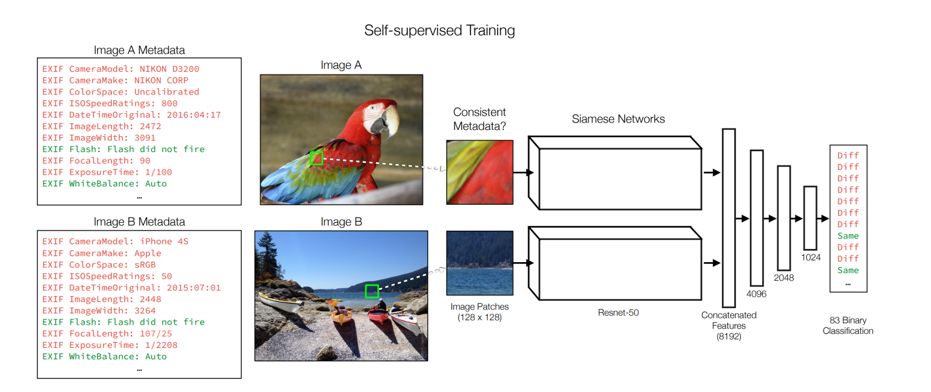
Model
9
55

Slide 14
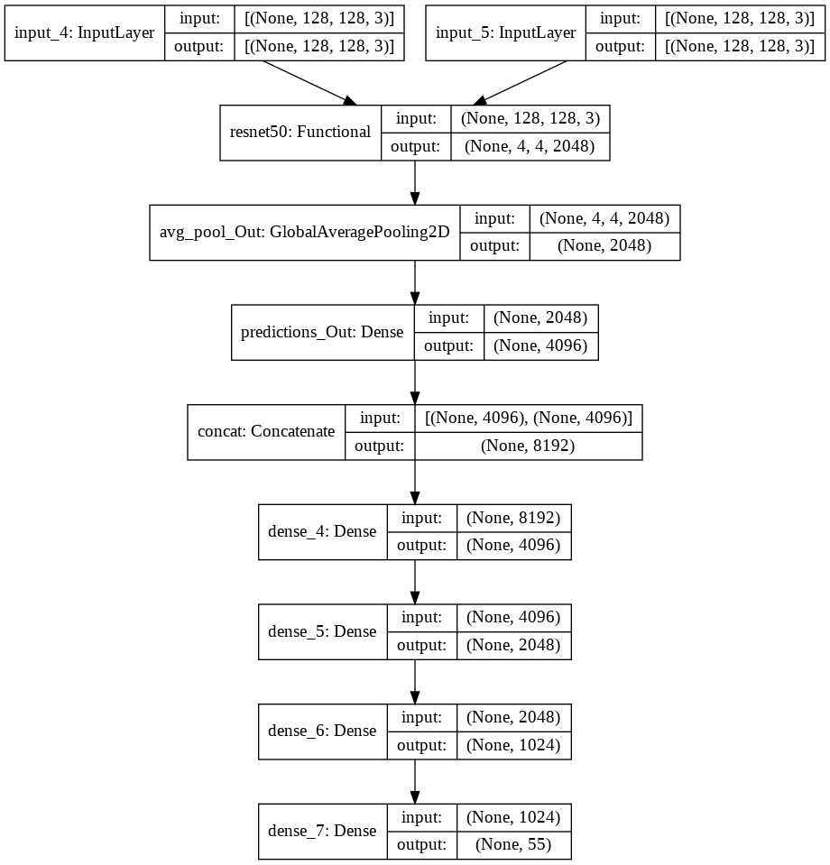
Resulting Keras Model
10

Slide 15

Preprocessing
3

Slide 16
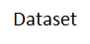
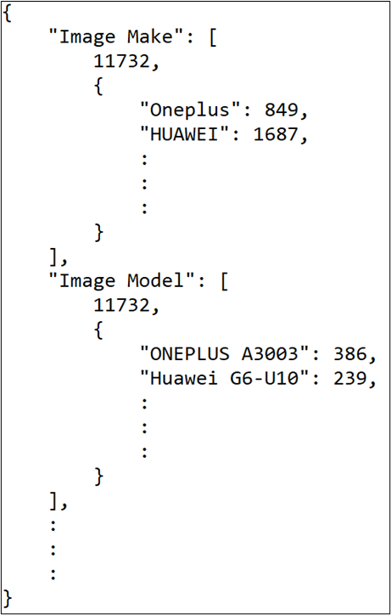
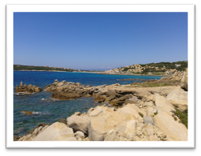
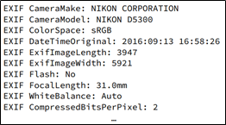

EXIF frequencies
11
Vision Dataset^{[3]}
11732 images
Image
Image EXIF
exifFrequencies.json

Slide 17
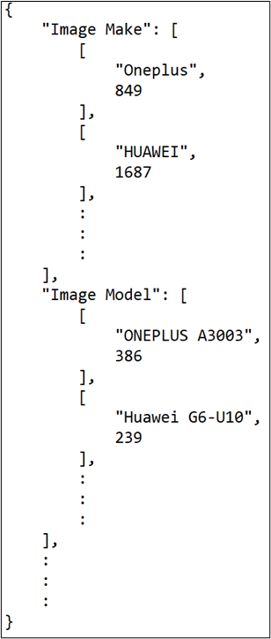
Whitelist
12
We removed:
Rare EXIF (less than 1466);
Rare EXIF value (less than 100);
EXIF with one value;
EXIF less significant.
exifFrequencies.json
whitelist.json

Slide 18
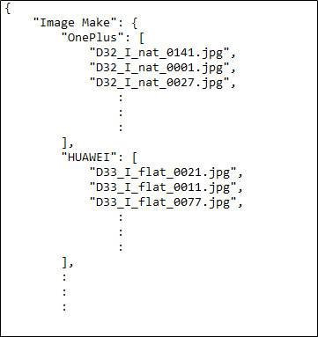

List of files by EXIF value
13
Vision Dataset^{[3]}
11732 images
Image
Image EXIF
ImagePerExif.json
Whitelist.json

Slide 19

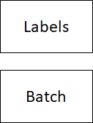
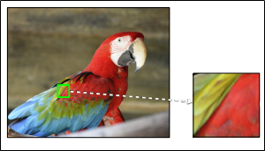
Batches and labels
14
ImagePerExif.json
128x128
128 couples
whitelist.json
Image choice
Patch creation
Batch creation

Slide 20
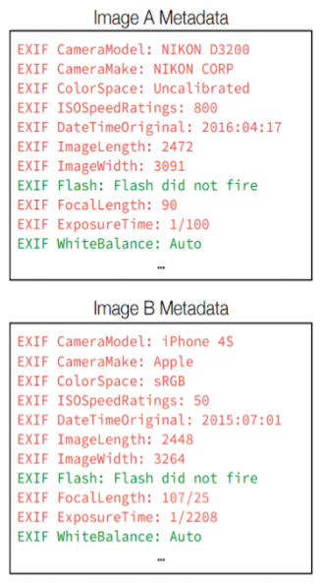
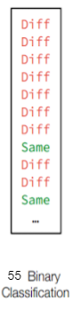
Label creation
15

Slide 21

Training and Validation
4

Slide 22




Training and Validation
17
Dataset
11732 images
Training
set
7500 images
Test
set
2116 images
+
201 In-Wild Test Set^{[4]}
Validation
set
2116 images
10000 patches
3 days
(Not consecutive)
Adam optimizer
LR 1e-4
Sigmoid cross entropy

Slide 23
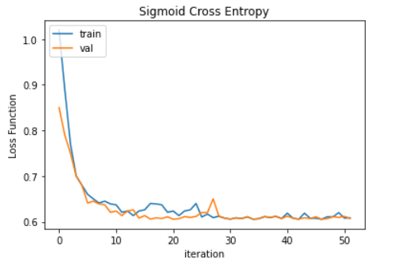
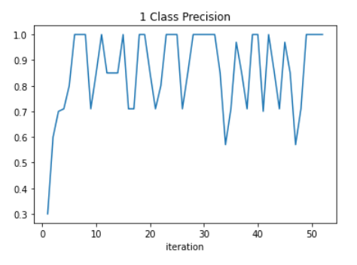
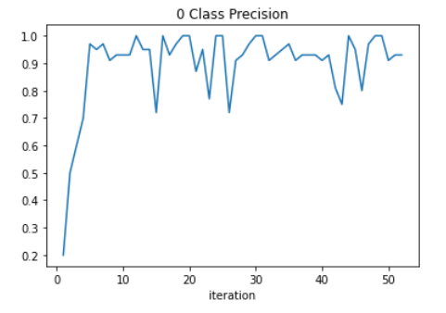
Training and Validation
18

Slide 24


Tests and Results
5

Slide 25
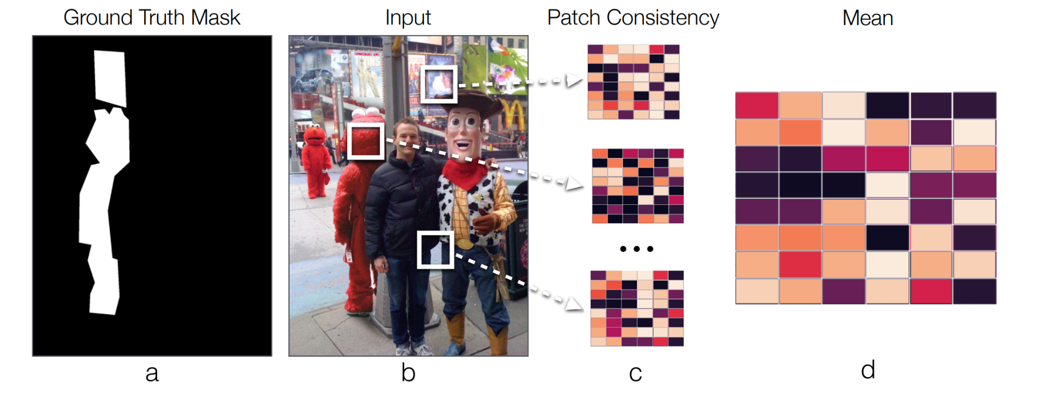
Tests and Results
20
Normalized Mean

Slide 26

Tests and Results
21
In-Wild Test Set^{[4]}
 | F1 Score | MCC Score | AP Score
Our Model | 0.29 | -0.08 | 0.14
They are quite bad, but...

Slide 27

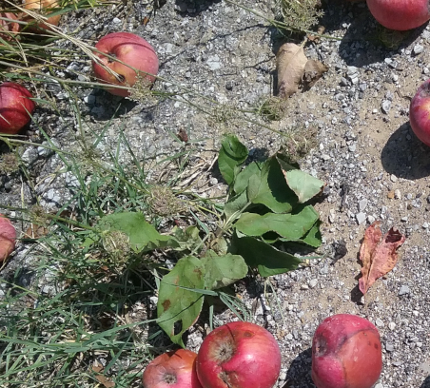
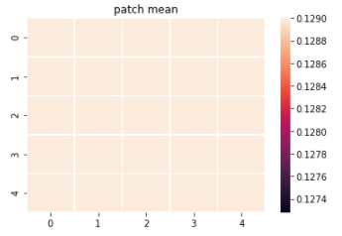
Tests and Results
22
…we tested it also on the Vision^{[3]} dataset
Non-Manipulated Image
Model

Slide 28

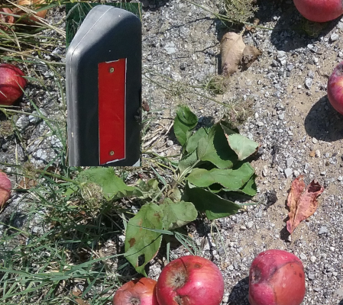
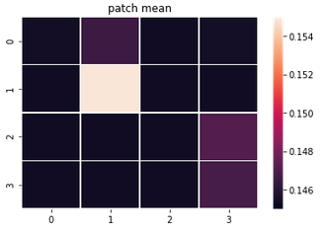
Tests and Results
23
Fake Image
Model

Slide 29

Conclusions
6

Slide 30
Conclusions: Possible Improvements
24
Include also other datasets
Try other architectures
Train for more time
More memory and more GPUs
Different approaches for batch building

Slide 31
References
25
Fighting Fake News: Image Splice Detectionvia Learned Self-Consistency https://arxiv.org/pdf/1805.04096.pdf
Deep Residual Learning for Image Recognition
https://arxiv.org/pdf/1512.03385
Vision Dataset
https://lesc.dinfo.unifi.it/VISION/
Image Splice Test Set
https://minyoungg.github.io/selfconsistency/in_wild/in_wild.tar.gz
Paper’s Code
https://github.com/minyoungg/selfconsistency

Slide 32
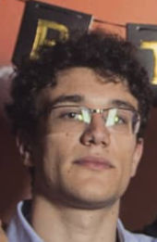

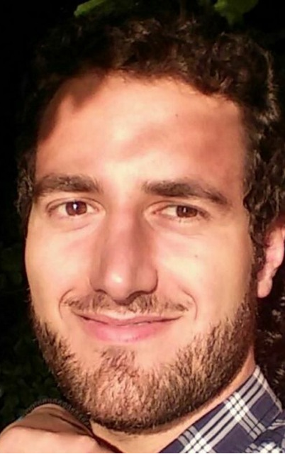
Thank you!
:)

